Slide 1
Working with Streams and Lambda Expressions in Java
Course Overview

Slide 2
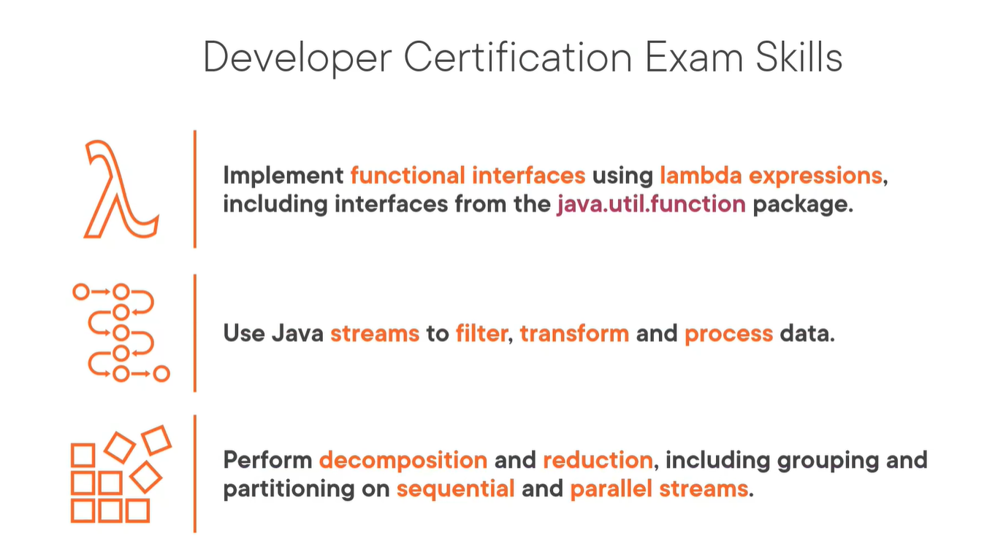

Slide 3
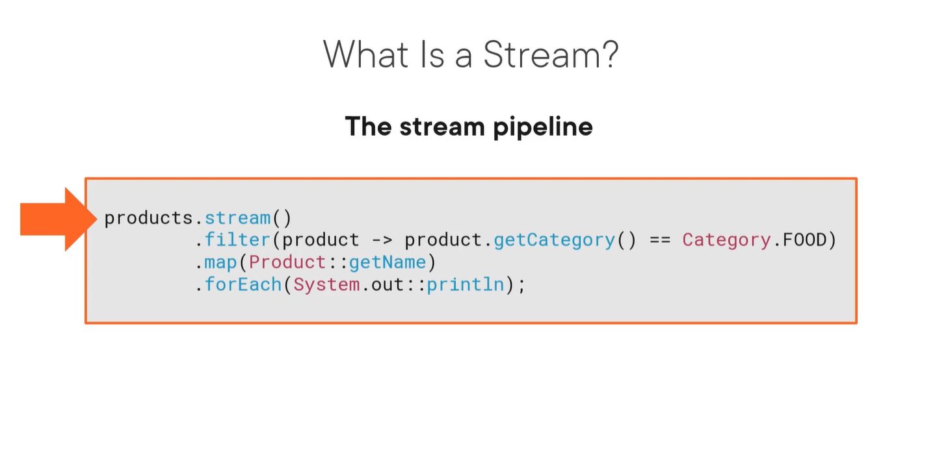

Slide 4
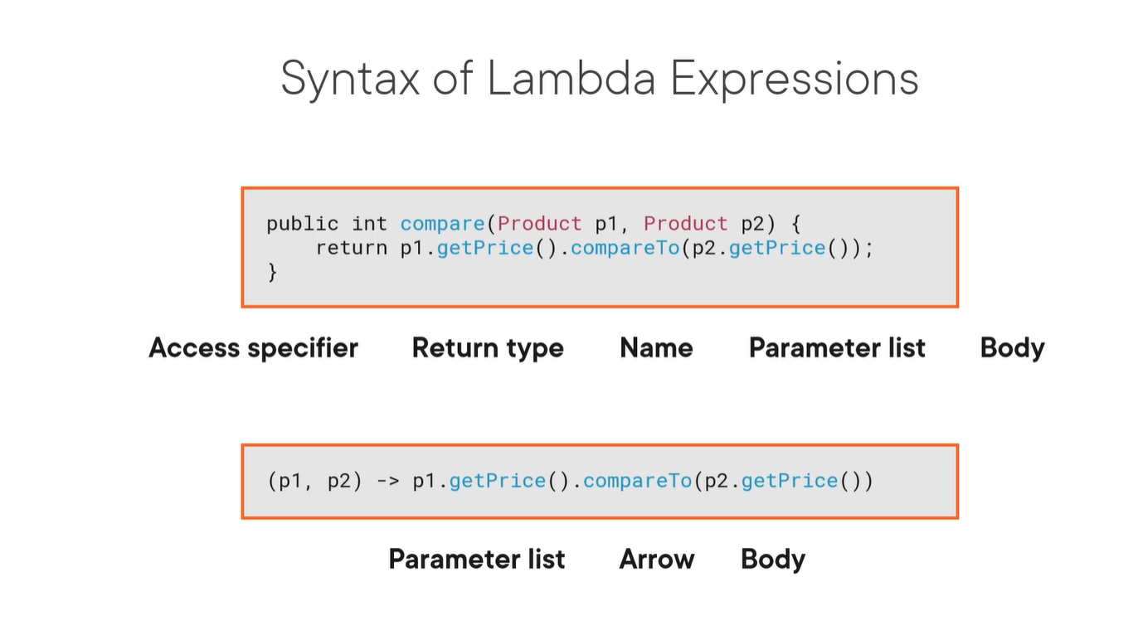

Slide 5
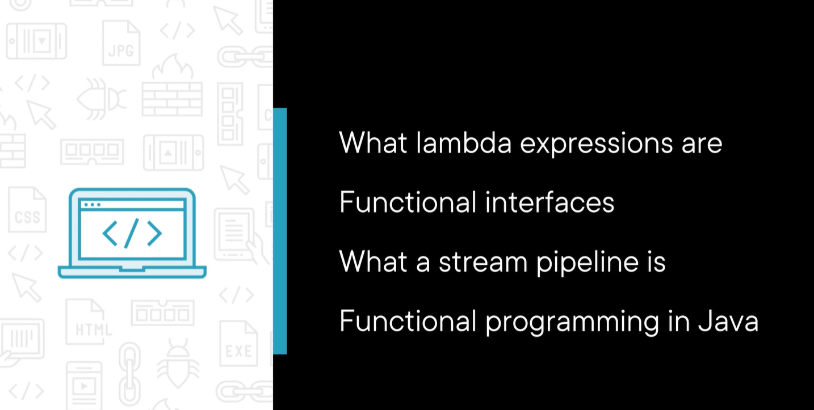

Slide 6
